Slide 1

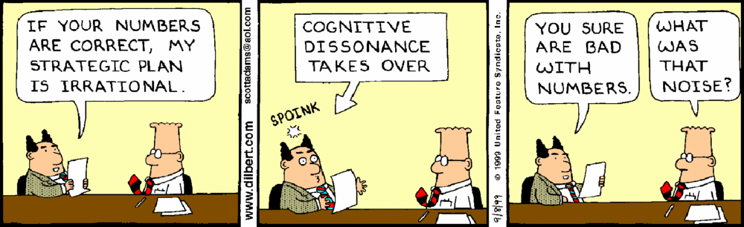
ANLY 6100: Data Analytics I Data Bias Exercise
Fall 2020 Intro Activity
Professor: Courtney Paulson

Slide 2
What is a Data Analysis?
We’ll get into this throughout the semester
When in doubt, though, consult Wikipedia!
“Data analysis is a process of inspecting, cleansing, transforming, and modeling data with the goal of discovering useful information, informing conclusions and supporting decision-making.”
What does this mean for us?
Get Data
????
Profit! (Logical Conclusions)
This is data analysis!

Slide 3
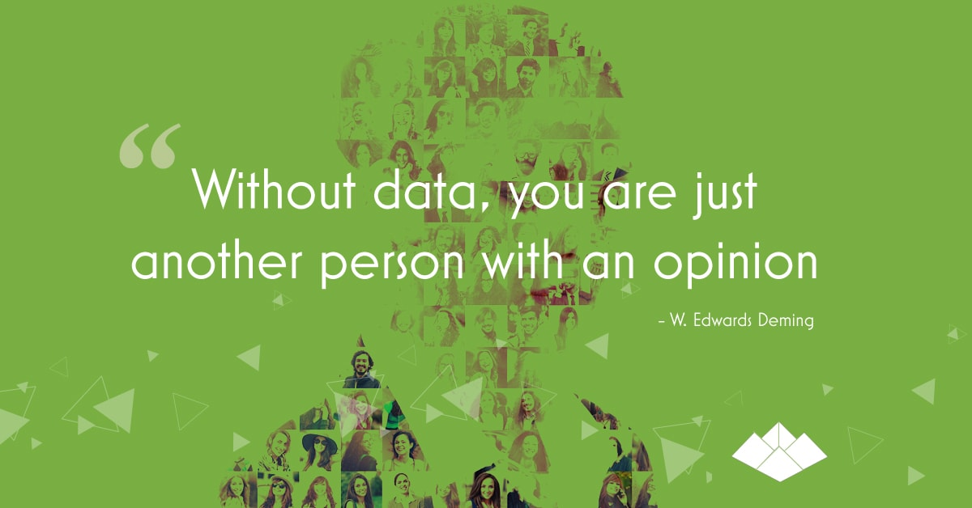
Image text: “Without data, you are just another person with an opinion.”
–W. Edwards Deming
Source: Pyramid Analytics

Slide 4




Why is this so hard?
The backfire effect (courtesy of The Oatmeal):
Image: Two cartoon birds in a tree. One whispers to other, “I’m going to tell you some things.”
Image: Two cartoon birds in a tree. Bird continues whispering, “You’re not going to believe these things I tell you.”
Image: Cartoon tree. Text: “And that’s okay.”
Image: Cartoon bird. Bird says, “You have good reason not to.”

Slide 5
Why is this so hard?
The backfire effect is a confirmation bias. What’s a confirmation bias?
Wikipedia to the rescue yet again: “Confirmation bias is the tendency to search for, interpret, favor, and recall information in a way that confirms or supports one's prior beliefs or values.”
So what’s psychology doing in a data class?!

Slide 6
Let’s get controversial!
Let’s dive right in. CivicScience has two curriculum questions for you:
Should schools in America teach Arabic Numerals as part of our curriculum?
Should schools in America teach the creation theory of Catholic priest George Lemaitre as part of our science curriculum?

Slide 7
The results are in!
56% of all respondents said no, Arabic numerals should not be taught in American schools
72% of self-identified Republicans said no
53% of all respondents said no, Lemaitre’s creation theory should not be taught in American schools
73% of self-identified Democrats said no

Slide 8

I’m going to say some things…
Listen to the following statements. Think about how much you agree with them. Think about why you agree with them. And notice how data is used in every single one.
Image: Sean Bean as Ned Stark in Game of Thrones. Image text: “Brace yourselves. Political memes are coming.”

Slide 9

“Depending on which study you look at, either 68% or 5 out of 6 individuals ... are making more on unemployment than they did on the job.” –Senator Ron Johnson in an August 2, 2020 interview on WISN-TV’s "UPFRONT" program
Clipart image of elephant

Slide 10

“When I was vice president, violent crime fell 15% in this country. ... The murder rate now is up 26% across the nation this year under Donald Trump.” –Vice President Joe Biden in speech to Pittsburgh, PA crowd on August 31, 2020
Clipart image of donkey

Slide 11
“Drug overdose deaths decreased in 2018 for the first time in 30 years.” –Detective Ryan Holets in an August 25, 2020 speech to the Republican National Convention
Clipart image of elephant

Slide 12
[Police are] “20.8 times more likely to kill than be killed by a criminal.” –State Senator Chris Larson (Milwaukee) in Facebook post on August 24, 2020
Clipart image of donkey

Slide 13
Why are we spending so much time on this?
When you become a data analyst, you become responsible for how your data/conclusions are used
Sad but true: you can make data say anything you want
Example (Statista):
More white people than black people are killed by police each year (in 2019, 370 white people vs. 235 black people)
But black people are killed at a much higher rate (at least 2.5 times)

Slide 14

Be Transparent and Complete!
YOU are going to be the trusted data source
Get practice now!
Every time you see a claim, consider the source
Check the data yourself, if possible
I will give you references and data for all statistics as much as I possibly can
Clipart image of figure with clipboard analyzing system

Slide 15
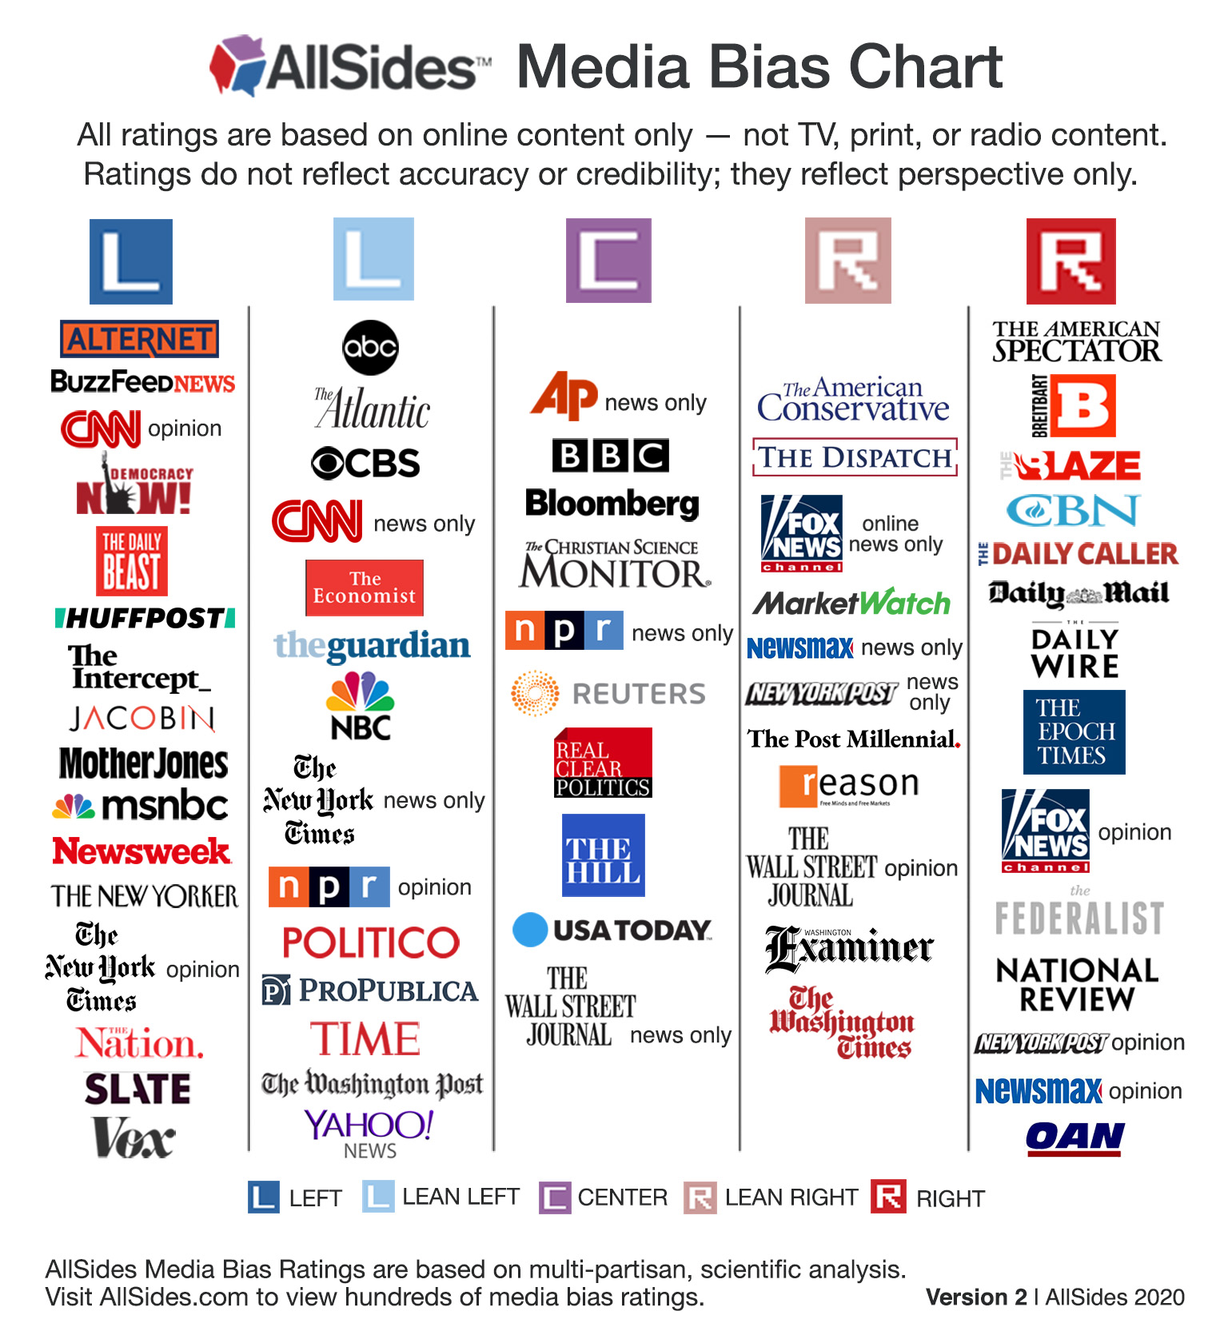
Some people do some of this for you
AllSides
Vanessa Otero/Ad Fontes

Slide 16
Let’s try an exercise on our own with COVID
We want to answer two questions:
How many people in the U.S. have died from COVID so far?
How likely are you personally to die from COVID?
Why do we need to do this ourselves?
This week: President Trump and other officials declare true U.S. coronavirus deaths are only 10,000
But official CDC numbers say 190,000
Which one is right? Why is there a difference?

Slide 17
How do we define a coronavirus death?
If I have diabetes, and I contract COVID and die, did I die from diabetes or from COVID? From both?
This is often compared to a bear attack:
If I have diabetes, and I get rushed to the hospital after I get attacked by a bear, but the hospital doesn’t have the appropriate medicine to treat complications from the bear attack due to my diabetes, did I die from diabetes or from the bear?
This is a standard often employed in homicide investigations: what brought about death most immediately?
But let’s forget that. It’s sticky and political. Let’s do something more clear cut
On Canvas in “Files” → “Class Activities”: US Deaths by Week.csv (CDC Data collected by Sanjay Vakil)
Question: Is the number of deaths due to COVID likely closer to 10,000 or 190,000?

Slide 18
Rebuttals to This Method
More elderly people in US → more deaths
Misleading due to complications
Not all people have same risk (conditional probability)
On Canvas in “Files” → “Class Activities”: us_states_covid19_daily.csv (Kaggle data obtained from COVID-19 Tracking Project and New York Times)
Explore the data to answer two questions:
Are you safer in Utah than other states?
Is COVID deadlier than the flu? (Influenza reports 0.1% mortality rate, but CDC also estimates 12,000 to 60,000 deaths with 9 million to 45 million cases each year)

Slide 19
Concluding Remarks
Welcome to data analytics!
Before Monday:
Download R and RStudio (or create an RStudio Cloud account) if you haven’t already done so and plan to use your own laptop
Some students find Rstudio Cloud easier on school computers for saving files
Reminder: Send me an email with your preferred email address for Data Camp if it isn’t the one I’ve been using!

Slide 20
R and RStudio
R (entirely free)
Choose country for download: https://cran.r-project.org/mirrors.html
USA example (UCLA download site): http://cran.stat.ucla.edu/
RStudio: https://www.rstudio.com/products/rstudio/download/
RStudio Cloud: https://rstudio.cloud/

Slide 21
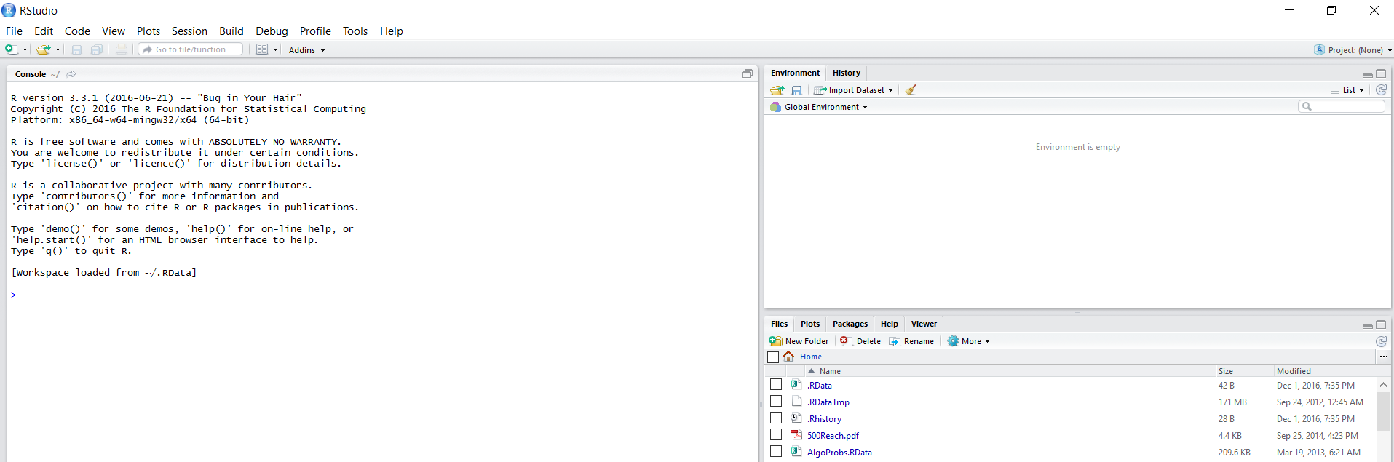
Getting Started
To use R:
First, download R
Next, download RStudio
When you open RStudio, you should see this:

Slide 22
RStudio: Basics
Environment Window (shows all objects loaded in session)
Import/Export Window (shows all computer files, R packages, plots, etc. that you might want to import or export using RStudio)
Main Console Window (for typing R commands, if you have code you’re trying to run)

